Slide 1

Author: Autar Kaw et. al.
Textbook: TEXTBOOK: NUMERICAL METHODS WITH APPLICATIONS

Slide 2
Simpson’s 1/3rd Rule of Integration

Slide 3

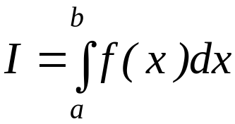
What is Integration?
Integration
y
f(x)
The process of measuring the area under a curve.
Where:
f(x) is the integrand
a= lower limit of integration
b= upper limit of integration
a
b
x

Slide 4
Simpson’s 1/3rd Rule

Slide 5
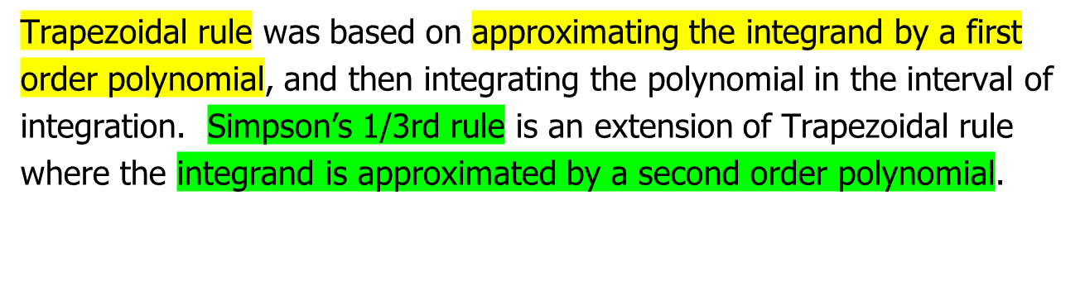
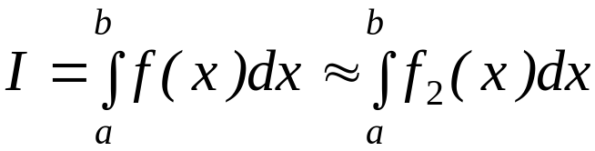





Basis of Simpson’s 1/3rd Rule
Hence
Where is a second order polynomial.

Slide 6
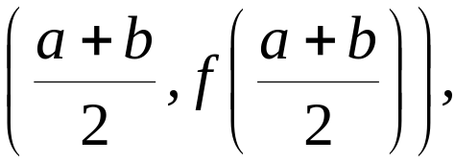




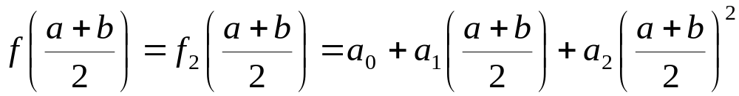

Basis of Simpson’s 1/3rd Rule
Choose
and
as the three points of the function to evaluate a₀, a₁ and a₂.

Slide 7
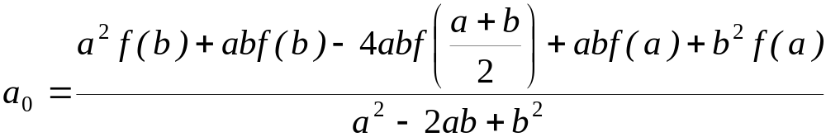
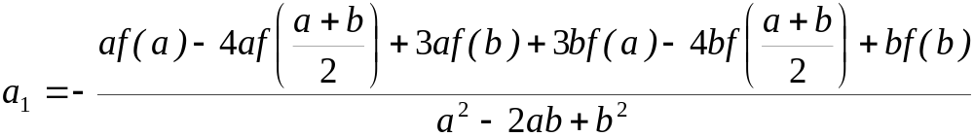
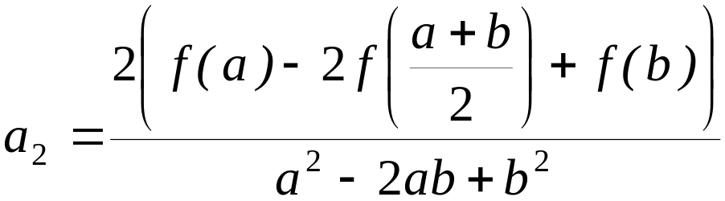
Basis of Simpson’s 1/3rd Rule
Solving the previous equations for a₀, a₁ and a₂ give

Slide 8
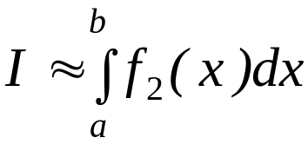
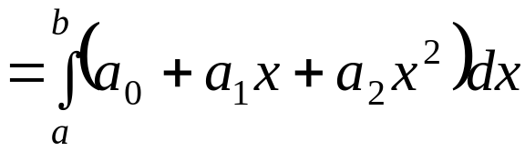
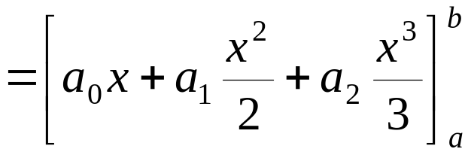
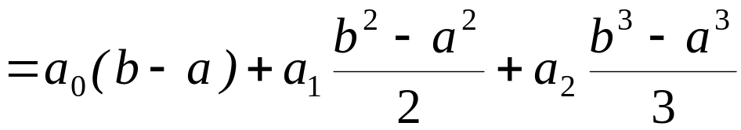
Basis of Simpson’s 1/3rd Rule
Then

Slide 9

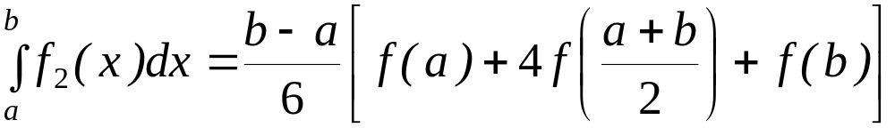










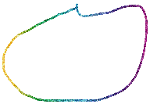
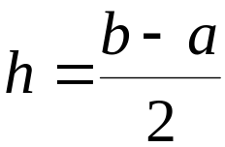


Basis of Simpson’s 1/3rd Rule
Substituting values of a₀, a₁, a ₂ give
Since for Simpson’s 1/3rd Rule, the interval [a, b] is broken
into 2 segments, the segment width

Slide 10

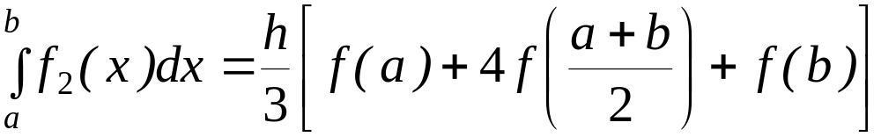

Basis of Simpson’s 1/3rd Rule
Hence
Because the above form has 1/3 in its formula, it is called Simpson’s 1/3rd Rule.

Slide 11
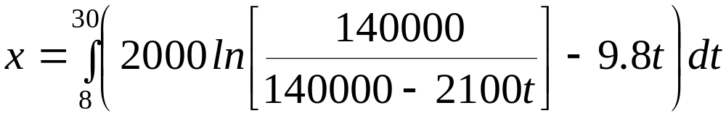


Example 1
The distance covered by a rocket from t=8 to t=30 is given by
a) Use Simpson’s 1/3rd Rule to find the approximate value of x
b) Find the true error,
c) Find the absolute relative true error,

Slide 12
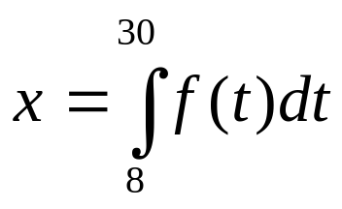
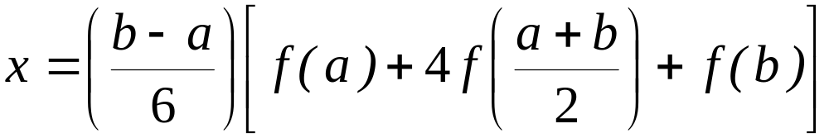
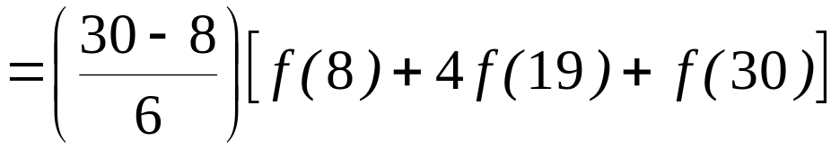
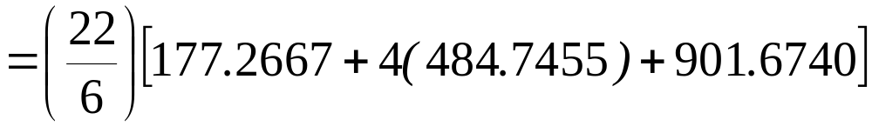

Solution
a)

Slide 13




Solution (cont)
True Error

Slide 14
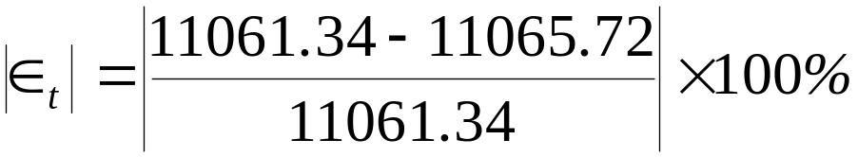

Solution (cont)
c) Absolute relative true error,

Slide 15


Slide 16
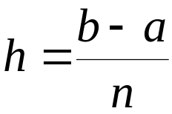
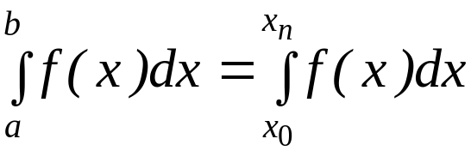


Multiple Segment Simpson’s 1/3rd Rule
Just like in multiple segment Trapezoidal Rule, one can subdivide the interval
[a, b] into equal segments, hence the segment width
where

Slide 17
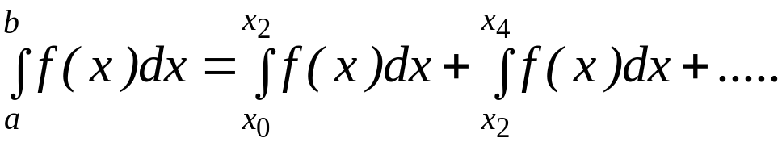
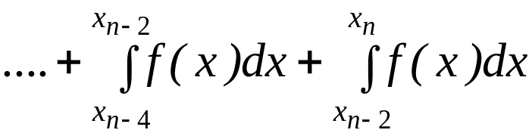
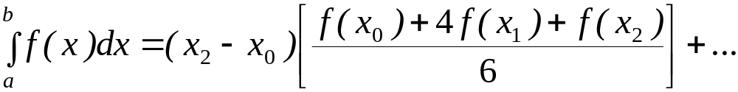

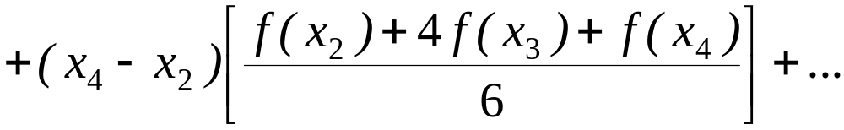

Multiple Segment Simpson’s 1/3rd Rule
f(x)
. . .
x
x₀
x₂
x_{n-2}
x_{n}
Apply Simpson’s 1/3rd Rule over each interval,

Slide 18
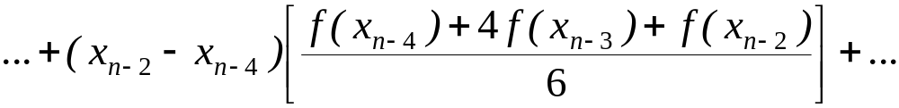
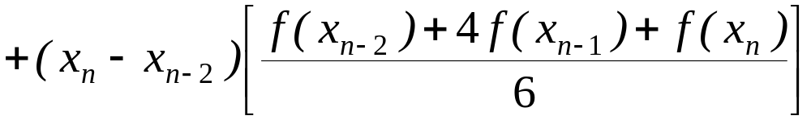


Multiple Segment Simpson’s 1/3rd Rule
Since

Slide 19
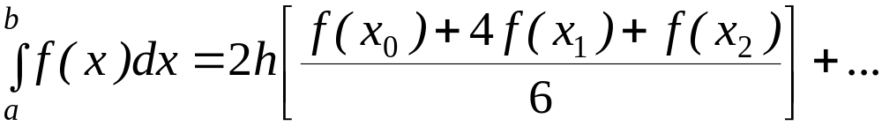
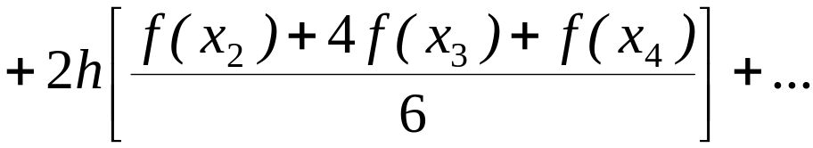
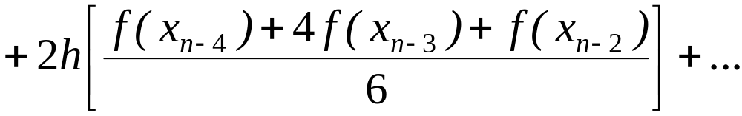
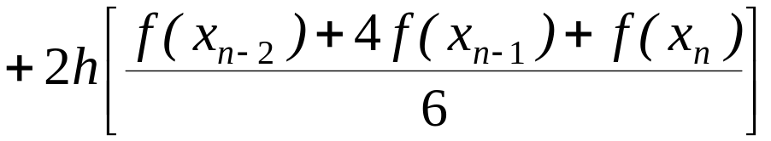
Multiple Segment Simpson’s 1/3rd Rule
Then

Slide 20
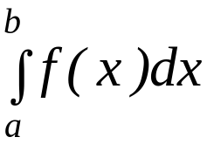
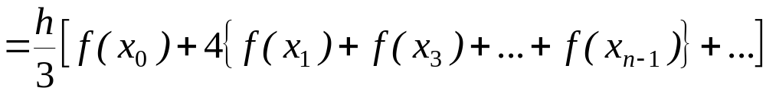
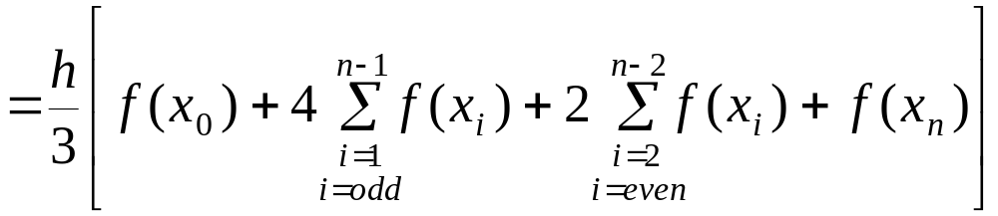

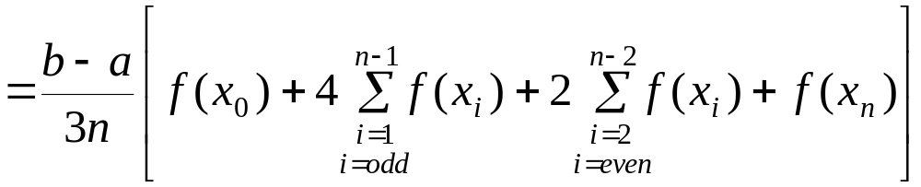




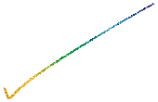



Multiple Segment Simpson’s 1/3rd Rule

Slide 21




Example 2
Use 4-segment Simpson’s 1/3rd Rule to approximate the distance
covered by a rocket from t= 8 to t=30 as given by
Use four segment Simpson’s 1/3rd Rule to find the approximate value of x.
Find the true error, for part (a).
Find the absolute relative true error, for part (a).

Slide 22

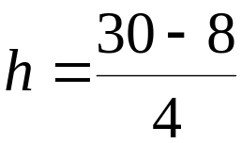

















Solution
a)
Using n segment Simpson’s 1/3rd Rule,
So

Slide 23
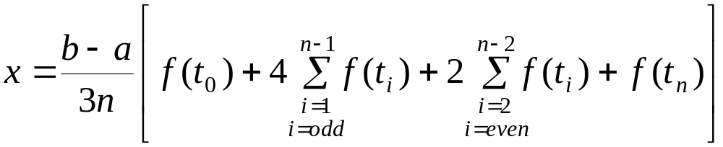


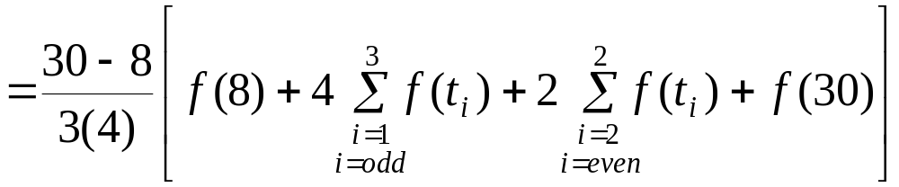
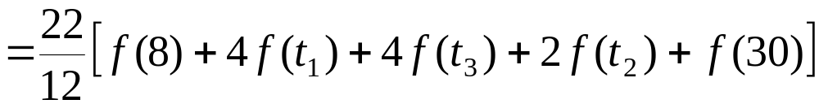


Solution (cont.)

Slide 24
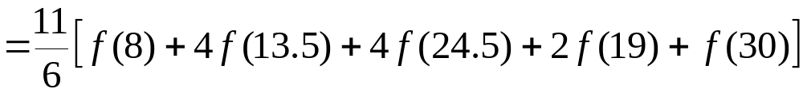


Solution (cont.)
cont.

Slide 25


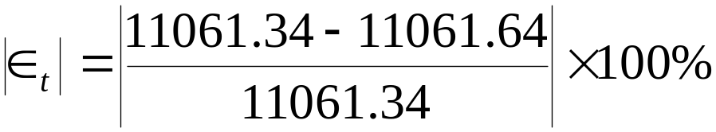
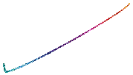

Solution (cont.)
In this case, the true error is
b)
The absolute relative true error
c)

Slide 26


Solution (cont.)
Table 1: Values of Simpson’s 1/3rd Rule for Example 2 with multiple segments
n | Approximate Value | E_{t} | |Є_{t} |
2 4 6 8 10 | 11065.72 11061.64 11061.40 11061.35 11061.34 | 4.38 0.30 0.06 0.01 0.00 | 0.0396% 0.0027% 0.0005% 0.0001% 0.0000%

Slide 27
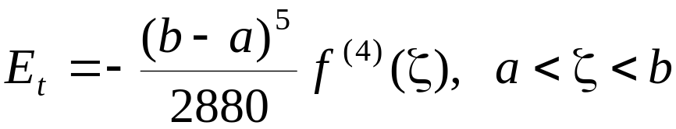






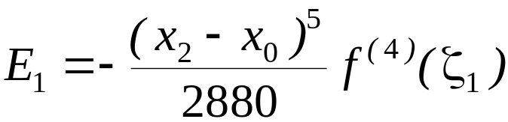
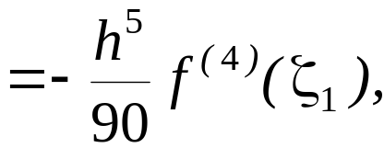

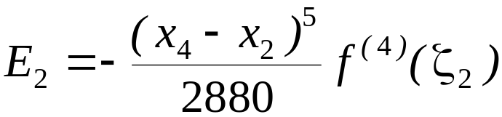


Error in the Multiple Segment Simpson’s 1/3rd Rule
The true error in a single application of Simpson’s 1/3rd Rule is given as
In Multiple Segment Simpson’s 1/3rd Rule, the error is the sum of the errors
in each application of Simpson’s 1/3rd Rule. The error in n segment Simpson’s
1/3rd Rule is given by

Slide 28









Error in the Multiple Segment Simpson’s 1/3rd Rule
.
.
.

Slide 29




Error in the Multiple Segment Simpson’s 1/3rd Rule
Hence, the total error in Multiple Segment Simpson’s 1/3rd Rule is

Slide 30




Error in the Multiple Segment Simpson’s 1/3rd Rule
The term
is an approximate average value of
Hence
where

Slide 31
THE END

